Slide 1

Introduction to Flutter
by Stephanie Patterson
PDX Cocoaheads
January 8, 2020

Slide 2
What is Flutter?
Flutter is an Open Source UI Toolkit created by Google to enable developers to build natively compiled mobile, web, and desktop apps with a single codebase.
Flutter comes with many pre-built widgets to easily layout your apps. (see Widgets Catalog and Community Dart Packages) ,
Flutter starts with a blank screen and then paints renderings (widgets, animations, etc.).

Slide 3
Why Use Flutter?
One codebase. No need to create a native iOS, Android, and web apps all in three different languages. (MacOS is currently in alpha)
No need to use potentially complex constraints to maintain layout(s) across variety of screen sizes.
Flutter apps are built using the Dart language which is very similar to other object-oriented programming languages.

Slide 4
Why Use Flutter? con’t
Hot reload enables Flutter developers to build UIs and make modifications and almost instantly see any changes.
Flutter is Open Source and you have access to the source code; no source behind proprietary wall. Which means you can customize implementation (i.e. you wanted rounder edges on a button).

Slide 5
Structure of a Flutter App
Scaffold
AppBar
Container
T
Column
Row
Text
T
Text
Icon

Slide 6
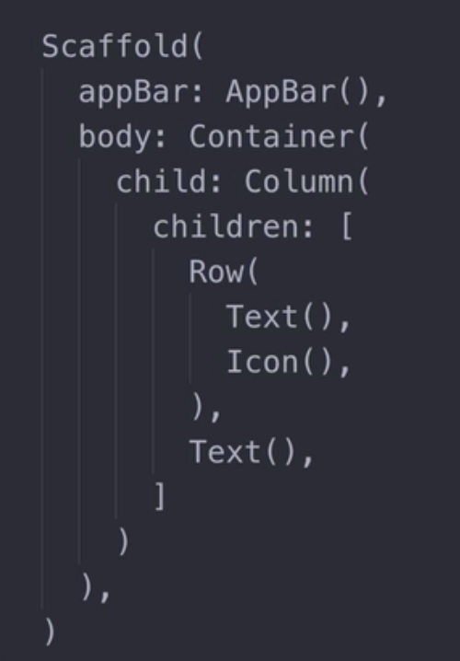
Structure of a Flutter App
T
T

Slide 7
Demo Time

Slide 8
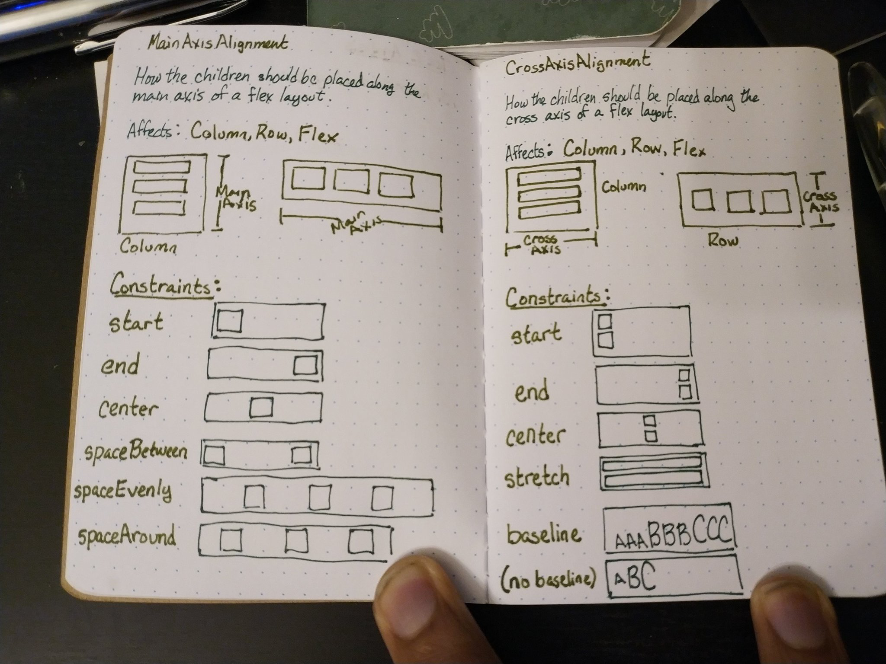
Axis Alignment
Source: https://twitter.com/ecspike/status/1192117455004549121

Slide 9
List of Resources
Getting Started with Flutter: http://flutter.dev
Flutter API reference documentation
Widget catalog: https://flutter.dev/docs/development/ui/widgets
Use https://dartpad.dev/flutter to code without installing; drop /flutter to just use Dart
Coming from another platform? Docs can be found each of these platforms: iOS, Android, Web, React Native, Xamarin

Slide 10
List of Resources con’t
Visit Google’s Flutter Developers’ YouTube playlist
Flutter Developers’ Widget of the Week series
Information about Flutter’s iOS Application Bundle
Material Design Library documentation
Flutter samples can be found on GitHub at https://github.com/flutter/samples/blob/master/INDEX.md

Slide 11
List of Resources con’t
Dart Packages - Find and use packages to build Dart and Flutter apps.
ListView Cheat Sheet- show a list of items
ListTile Cheat Sheet ListTile, an alternative to ListView
Flutter Layout Cheat Sheet, in more detail than above
Flutter Animations Cheat Sheet or expanded at Codemagic

Slide 12
List of Resources con’t
London App Brewery UDEMY course, co-developed with Google.
London App Brewery course resources on GitHub
Pawan Kumar, a Flutter GDE, created a YouTube video series called Learn Flutter Like A PRO By Building Apps
Flutter Community sites

Slide 13
Platforms supported
Flutter
SwiftUI
iOS
Android
Web (in beta)
MacOS (in alpha)
Windows (in dev)
Linux (in dev)
Apple platforms only

Slide 14
Questions?

Slide 15
Stef’s contact info
Twitter: @GeekMeSpeakStef
Email: stephanie@GeekMeSpeak.com
Demo resources:
Gists: https://gist.github.com/Stef-GMS
App: https://github.com/Stef-GMS/pdx_cocoaheads_demo_flutter_2020_01_08

